Slide 1

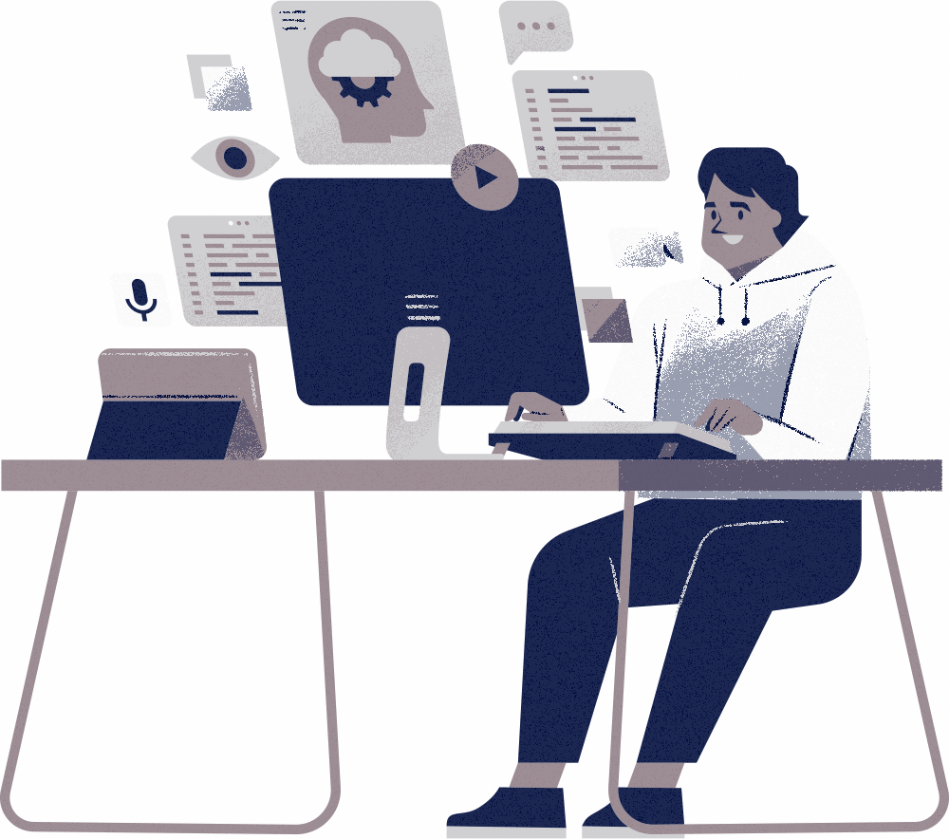

01
Building a Real-Time Collaborative Drawing Board
A Deep Dive into Modern Web Architecture
Suhail

Slide 2

INTRO
02
Agenda
Intro
Technical Architecture
Multi tenant architecture
Pouch & Couch DB
Real time sync
Demo
Challenges
Q&A
Thanks

Slide 3
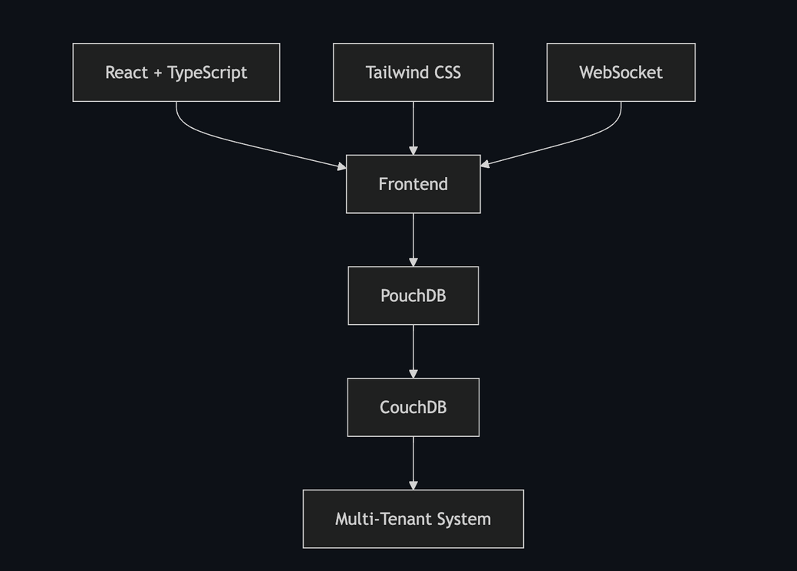
TECHNICAL ARCHITECTURE
03
Tech Stack
Technology | Benefits
React + TS | Type safety, Component reuse
PouchDB | Offline-first, Real-time sync
Tailwind | Rapid UI development
Firebase | Social Authentication

Slide 4
TECHNICAL ARCHITECTURE
04
Access Control Matrix
Multi-Tenant Architecture
Action | Private | Shared | Public
View | Owner | Collaborators | Everyone
Edit | Owner | Collaborators | None
Share | Owner | None | N/A
Delete | Owner | None | None
🔐 Tenant Isolation
🚦 Access Control
🔑 Authentication
📝 Audit Trails

Slide 5
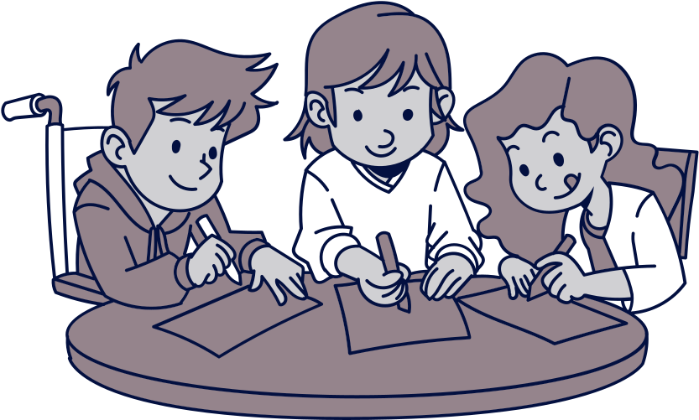
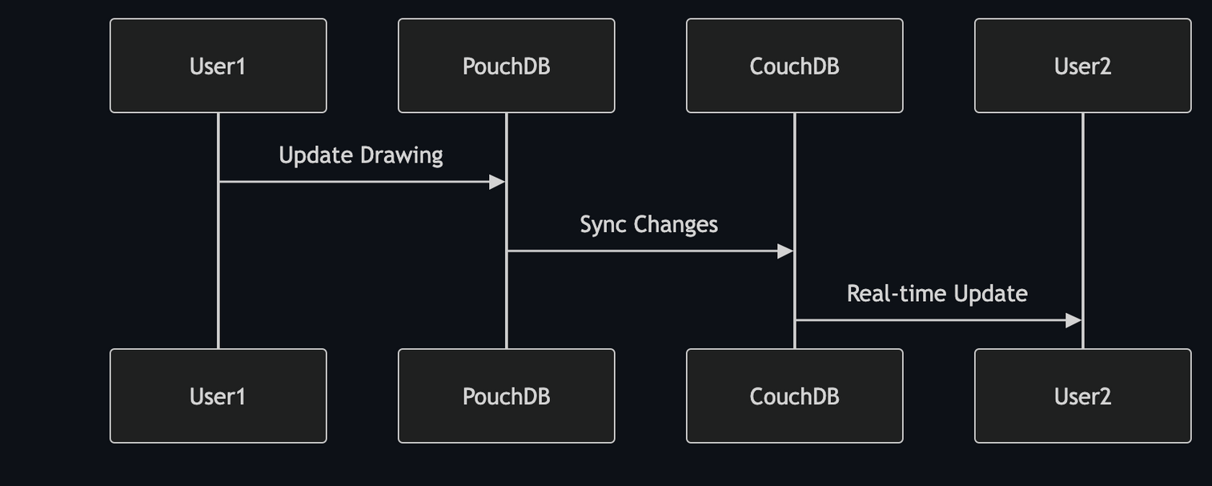
TECHNICAL ARCHITECTURE
05
Real Time Sync

Slide 6


PAUCEK AND LAGE
09
Challenges and Solutions
Storing Eraser tool details and handle that in a proper way.
When realtime sync DB got overloaded or closing the connection.

Slide 7
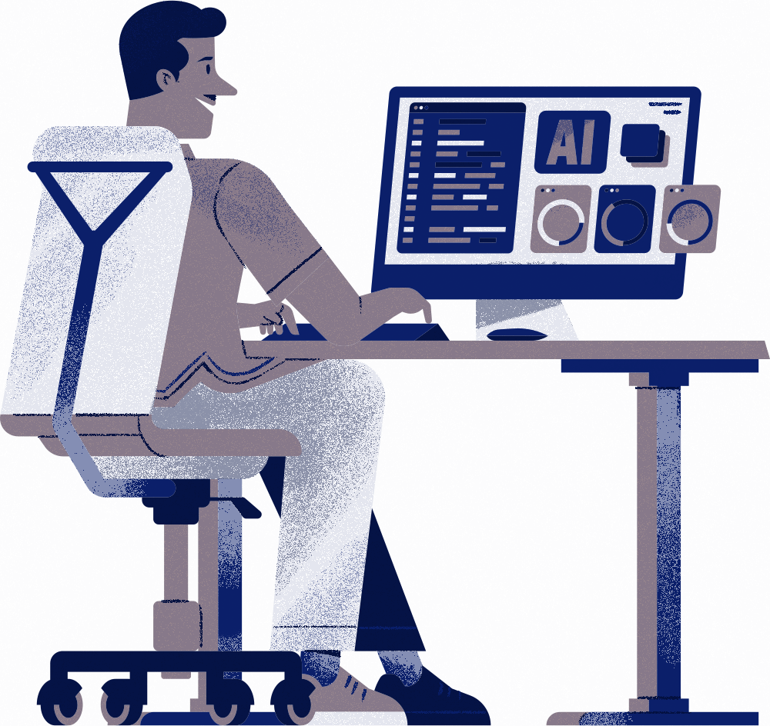
10
THANK YOU
https://github.com/Demonbruster/collaborative-app-tech-talk-demo
Suhail

